Slide 1

In the name of God

Slide 2
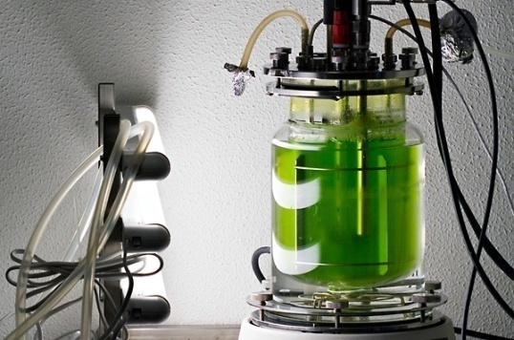
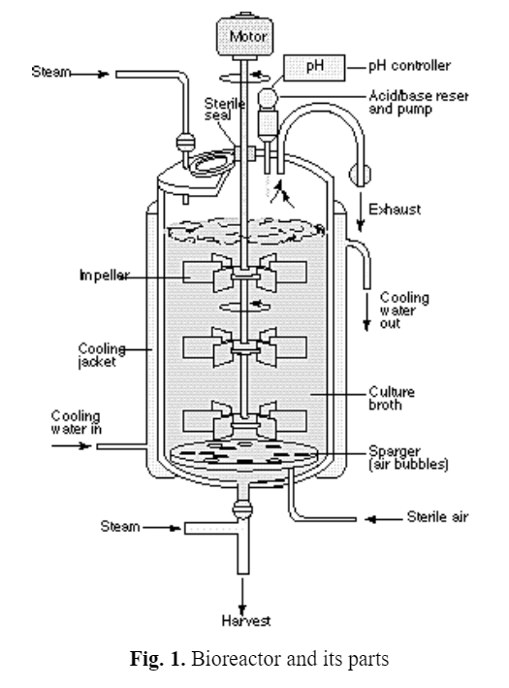

Ideal Reactor Operation
Mohammad Amin Hejazi
Prof. of Food Biotechnology,
Agricultural Biotechnology Research Institute of Iran

Slide 3
The aims of Bioprocesses
Production of Biomass
Production of Enzymes
Production of Metabolites
Biotransformation

Slide 4
Success of a bioprocess depends on
Biocatalyst
Bioreactor type
Mode of bioreactor operation
Medium
Control of operation conditions

Slide 5
Desirable qualities for effective microorganisms in industrial use
Ability to grow in culture
Genetic stability
Ability to efficiently produce a target product in a short time period
Limited need for additional growth factors
Utilization of a wide range of low-cost and readily available carbon sources
Amenability to genetic engineering
Non-pathogenicity
Readily harvested from the fermentation process
Limited production of byproducts to simplify purification
Production of spores or other reproductive cells (to allow inoculation into large fermenters)
Ability to protect itself from contamination by other microbes
Relatively large cell size, to allow faster settling or simpler filtering

Slide 6
Batch type operation

Slide 7
Batch type operation

Slide 9
Batch type operation

Slide 10
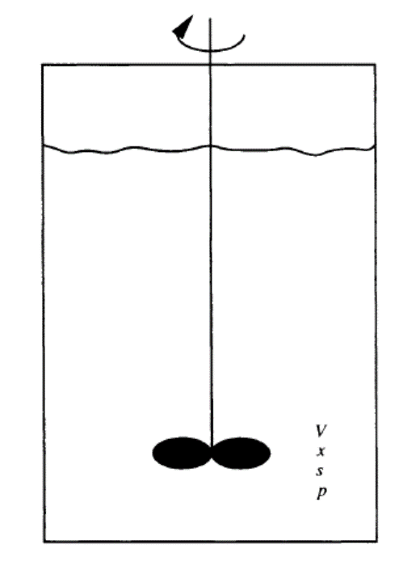
Batch type operation

Slide 11

Batch type operation

Slide 12
Example

